Slide 1
HanaBudget
An Expense Tracker App

Slide 2
What’s the Pitch?
Meet HanaBudget: the friendly and simple expense tracker app. Built with Flutter for a smooth ride on any mobile device and utilizing Atlas MongoDB for local database management, it ensures your financial data is always at your fingertips, secure, and up-to-date. Whether you’re watching your spending, setting up budget goals, or just curious where your money goes, HanaBudget has your back. It’s your go-to finance buddy in this busy, connected world, helping you stay on top of your money game without breaking a sweat.

Slide 3
The Team!
Mark Denina
Alexis Cruz Aboytes
@mdenina1
@ChicoQuemador1
Link to repository:
https://github.com/ChicoQuemador1/HanaBudget

Slide 4
Contents of this template
You can delete this slide when you’re done editing the presentation
Fonts | To view this template correctly in PowerPoint, download and install the fonts we used
Used and alternative resources | An assortment of graphic resources that are suitable for use in this presentation
Thanks slide | You must keep it so that proper credits for our design are given
Colors | All the colors used in this presentation
Icons and infographic resources | These can be used in the template, and their size and color can be edited
Editable presentation theme | You can edit the master slides easily. For more info, click here
For more info: SLIDESGO | BLOG | FAQs
You can visit our sister projects: FREEPIK | FLATICON | STORYSET | WEPIK | VIDEVO

Slide 5
Table of contents
01
02
03
04
05
06
Introduction
Problem & solution
Market opportunity
Product demo
Team & timeline
Financial & metrics

Slide 6
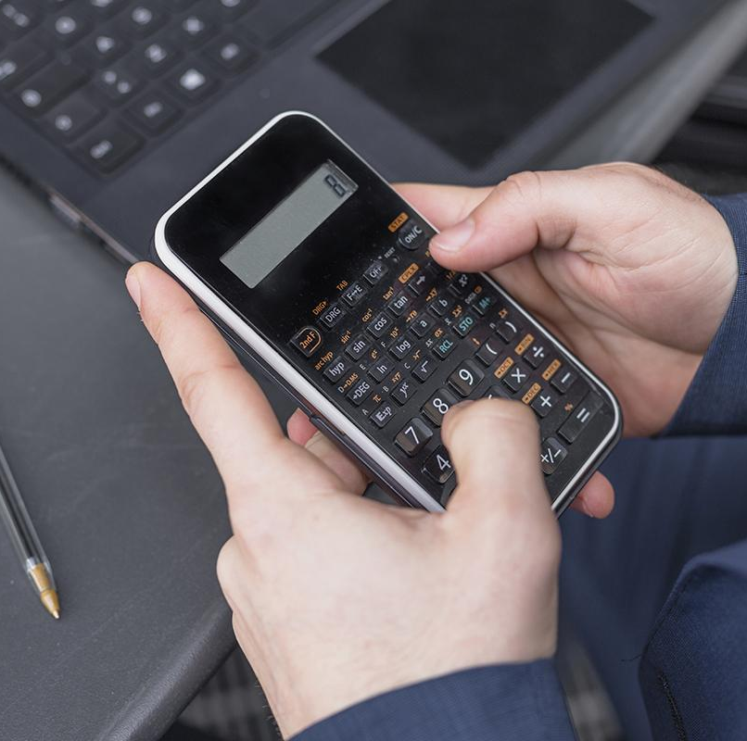
01
Introduction

Slide 7
Introduction
Our company
The introduction of your company in the pitch deck should include a brief overview of who you are and what you do. It should also include a brief description of why your product or service is unique and the value it provides to customers
Our idea
The “our idea” part of a pitch deck should include an explanation of your product/service, how it works, and what the customer value is. You should also explain the market opportunity for your product/service

Slide 8
Key ideas in market opportunity
Research new markets
Innovative solutions
Analyze existing customer needs and identify gaps in the market to find new opportunities
Utilize technology and customer feedback to come up with novel solutions that meet your customer’s demands or needs
Stay ahead of trends
Seasonal spikes
Monitor changes in the marketplace, such as shifts in consumer behavior, to stay competitive and capitalize on new opportunities and trends
Identify times of year when demand for certain products may spike, such as holidays or special occasions, and use these times to target customers

Slide 9
Six recommendations
Keep it simple
Use visuals
Keep it short
Structure your pitch deck clearly and make sure all the important points are easy to understand
Incorporate visuals or graphics to illustrate your message and keep the audience engaged
A good pitch deck should be concise and clear; avoid trying to cram in too much information
Make it memorable
Test & iterate
Main points
Include impactful stories, statistics, or facts that will help your audience remember your
message afterwards
Practice presenting your deck beforehand with friends or colleagues for feedback, then use this input to refine it further
A pitch deck is an overview of your business; focus on key points that get the most important ideas across

Slide 10
333,000
9h 55m 23s
386,000 km
Users bought our product
Estimated delivery time per unit
Avg. distance travelled by logistics team

Slide 11
78,300,000
Number of users analyzed in our market research

Slide 12
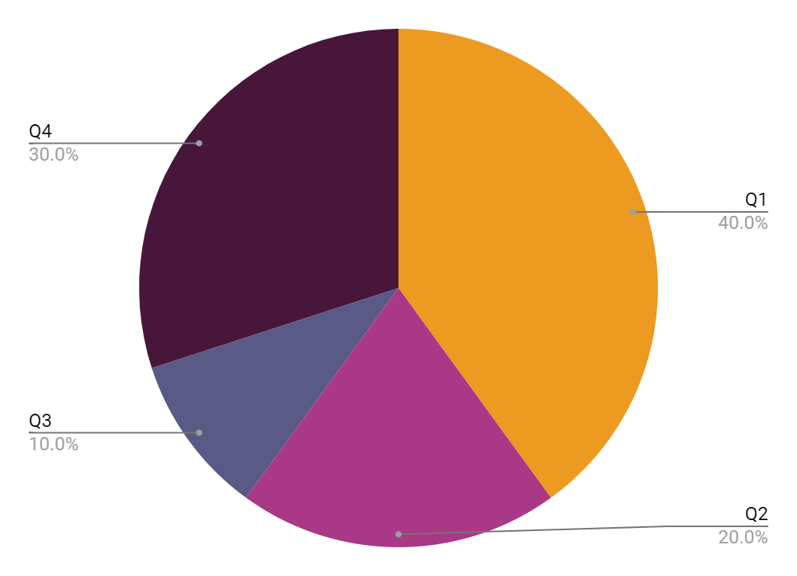
Revenue by quarter
Q1
Q2
Q3
Q4
January - March
April - June
July - September
October - December
Follow the link in the graph to modify its data and then paste the new one here. For more info, click here

Slide 13
Competition comparison
 | Features | Value | Pricing | Trial | Competence
Company A | Fuel economy | Special offers | $23,000 | No | Low
Company B | Design | Reliability | $27,000 | No | Low
Company C | Performance | Repairs | $30,000 | Yes | High
Company D | Safety features | Marketing | $24,000 | No | High
Company E | Technology | Customers | $32,000 | Yes | Low
Company F | Comfort | Best prices | $15,000 | Yes | High

Slide 14

Product infographic
Visuals
Features
Showcase the design of your product
What makes you product unique?
Price
Users
Share the cost and price with investors
Speak about the target audience
Availability
Updates
When is the product expected to be ready?
Do you plan on updating it?

Slide 15
Timeline of your presentation
01
02
03
04
Provide a brief overview of the pitch deck's content
Engage the audience with a compelling introduction
Identify the customer's pain points and challenges
Describe how your product or service can solve the problem
05
06
07
08
Highlight the unique value proposition and benefits of your specific solution
Analyze the target market size and competition briefly
Explain your financial needs and briefly outline your funding allocation
End with a clear and concise call to action

Slide 16
Organizational chart
John Doe
CEO
Jane Smith
Department Head
Mark Willson
Department Head
Emma Miller
Manager
Richard Taylor
Manager
Sarah Williams
Manager
Brian Clark
Employee
Michelle García
Employee
James Scott
Employee
William Young
Employee
Alan Turner
Employee

Slide 17
Market size overview
265 k
125 k
74 k
Outer circle
Middle circle
Inner circle
Include the total size of the market, which represents the entire potential customer base for the product or service
Identify the target market for the product or service. This could be based on factors such as geography, or specific needs
Indicate the current market size, which represents the portion of the target market that the company has successfully captured

Slide 18
Roadmap infographic
 |  |  | Phase 1 |  |  | Phase 2 |  |  | Phase 3 |  |  | Phase 4
Initiative | % Done | Objective | Jan | Feb | Mar | Apr | May | Jun | Jul | Aug | Sep | Oct | Nov | Dec
Understanding | 20% | Analyze and understand the needs of your target audience
Conduct research | 10% | Research existing products in the industry
Brainstorm ideas | 60% | Generate ideas based on user feedback
Develop a prototype | 40% | Create a basic version of the product to show investors
Test for usability | 80% | Put the prototype through rigorous testing processes

Slide 19
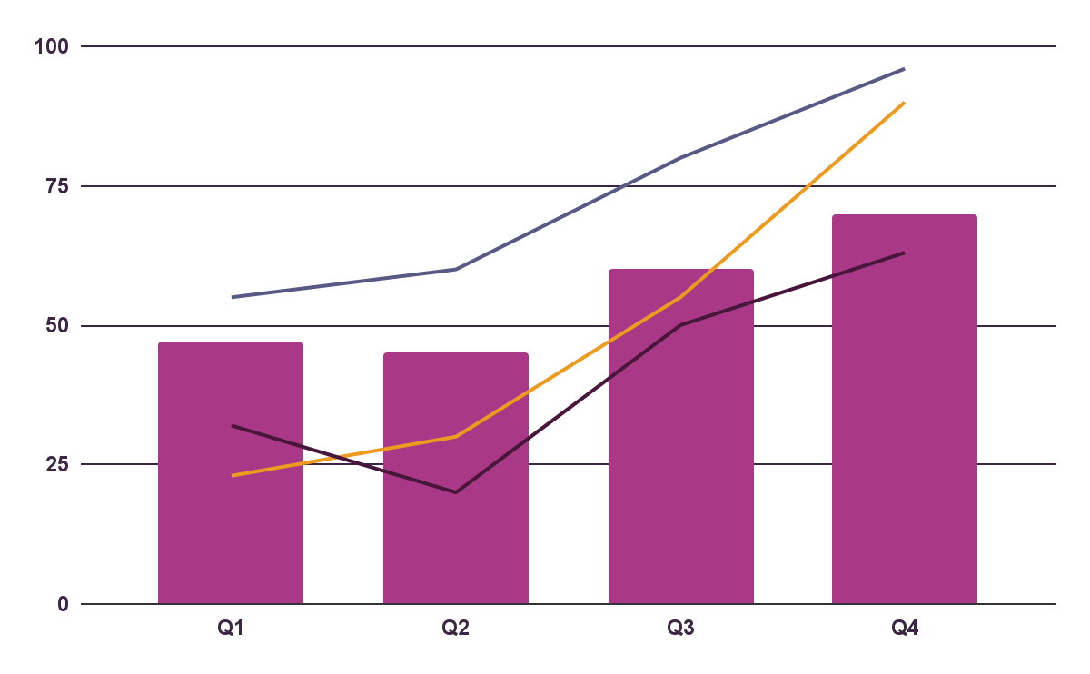
KPI dashboard
$4,000,000
$100,000
$5,000
Revenue
General costs
Profit
Product | Units | Revenue | Returns
Item 1 | 500 | 2,000,000 | 40
Item 2 | 1,000 | 50,750 | 10
Item 3 | 250 | 1,500,000 | 300
Item 4 | 500 | 2,000,000 | 40
Item 5 | 1,000 | 50,750 | 10
Follow the link in the graph to modify its data and then paste the new one here. For more info, click here

Slide 20
Thanks!
Do you have any questions?
youremail@freepik.com
+34 654 321 432
yourwebsite.com
Please keep this slide for attribution

Slide 21
Icon pack

Slide 22
Alternative resources
Here’s an assortment of alternative resources whose style fits the one of this template:
Vectors
Technology concept landing page template
Icons big data background

Slide 23
Resources
Did you like the resources on this template? Get them for free at our other websites:
Photos
Top view woman typing on laptop
Businessman on a terrace
Vectors
Flat design data driven illustration I
Flat design data driven illustration II
Icons pack
Icon Pack: Money | Filled

